Slide 1

Twitter Data Sentiment Analysis
Final Project
Dean D’souza
H.U. ID: 168424

Slide 2
Emotion Expressed by Tweet
Layin n bed with a headache ughhhh...waitin on your call... (sadness)
wants to hang out with friends SOON! (enthusiasm)
I HATE CANCER. I HATE IT I HATE IT I HATE IT. (worry)
I missed the bl***y bus!!!!!!!! (neutral)
Successfully following Tayla!! (happiness)

Slide 3
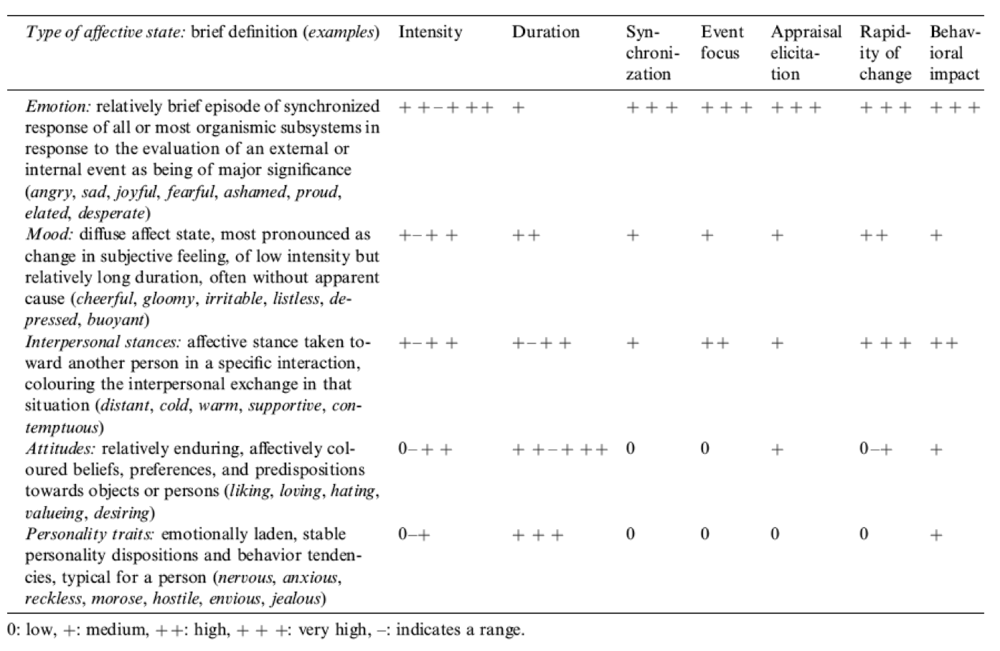
Project Goal
Emotion Detection: is a person happy, sad, angry, etc.? Can a tweet really be representative of this emotion and can it be identified by a machine?
Scherer Typology of Affective States:
Emotion: brief organically synchronized
evaluation of a major event
angry, sad, joyful,
fearful, ashamed, proud, elated

Slide 4
Dataset
Description and analysis

Slide 5
Source:
The data was obtained from crowdflower.com/data-for-everyone
Data consists of following fields:
TweetID
Sentiment
Author
Content
Data was annotated by the crowdflower platform to represent 12 emotion states [3].

Slide 6
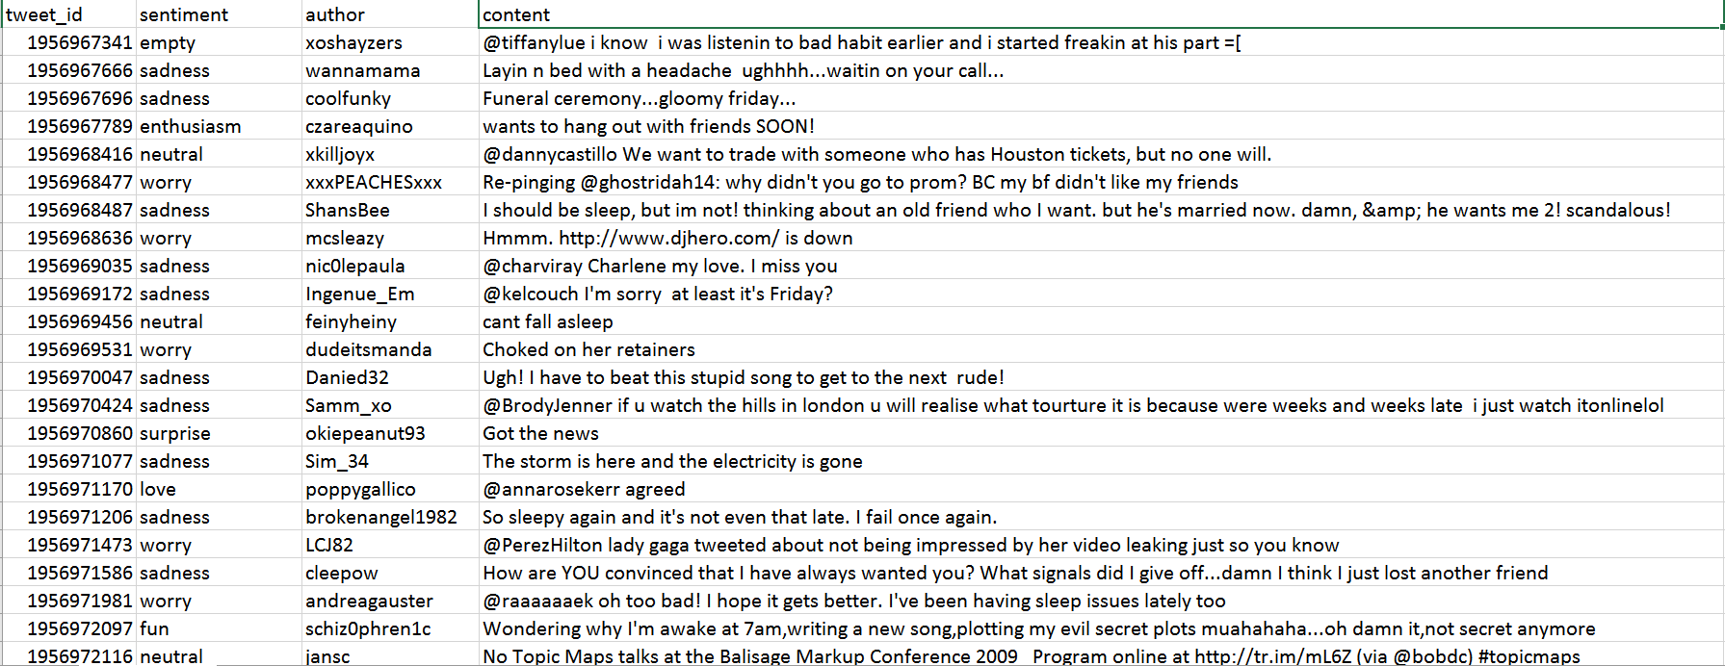
Sample:

Slide 7
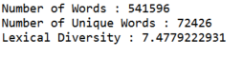
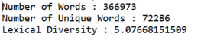
Basic Statistics of the Data:
Total size of text present in the contents = 2977515
Before removing stopwords :
After removing stopwords (list obtained from the stopwords corpus supplied with nltk):

Slide 8
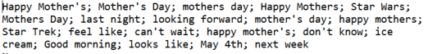
Collocations:

Slide 9
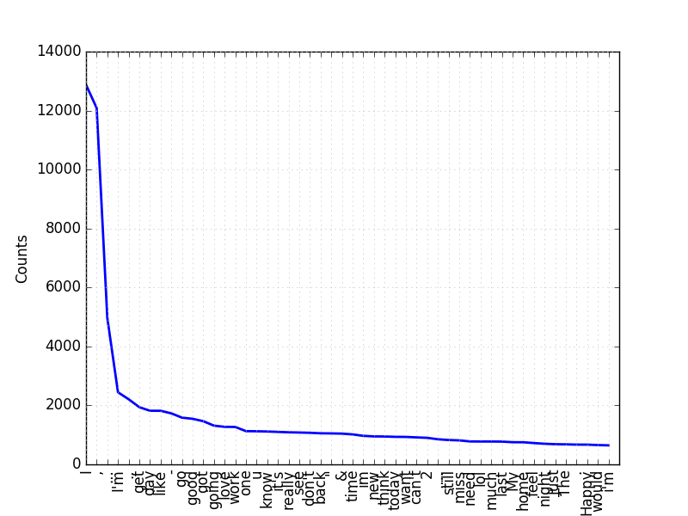
Frequency Distribution of Tokens:

Slide 10
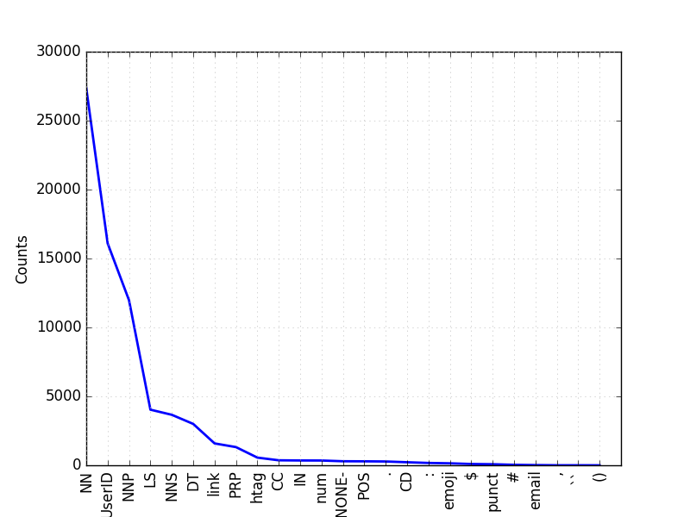
Frequency Distribution of Tagged Tokens:

Slide 11
Naïve Bayes Classifier
Building the Model

Slide 12
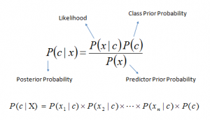
Naïve Bayes Classifier:
Naïve Bayes classifier is based on the assumption of independence of each feature, and it can combine contributions of different features without worrying about interactions.
It is based on the “bag of words” representation of a document
It’s mathematical formula is as follows:

Slide 13
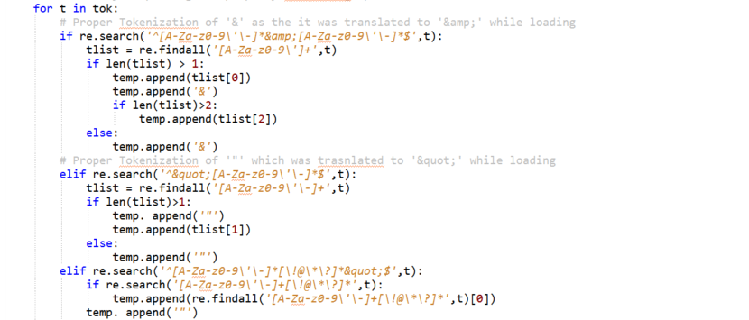
Tokenization:
As the data had many occurrences of ‘&quot;’ and ‘&amp;’ for quotations and ‘&’ respectively, a custom Tokenizer was built, part of it as follows:

Slide 14
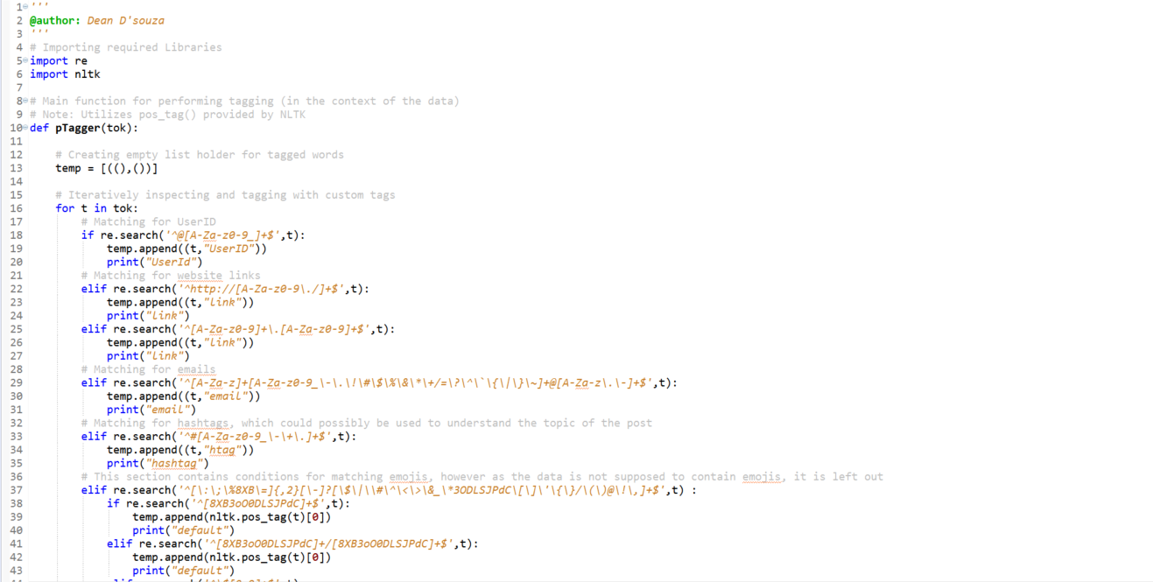
Tagging:
A part of speech tagger was also implemented
Not added to the classifier

Slide 15
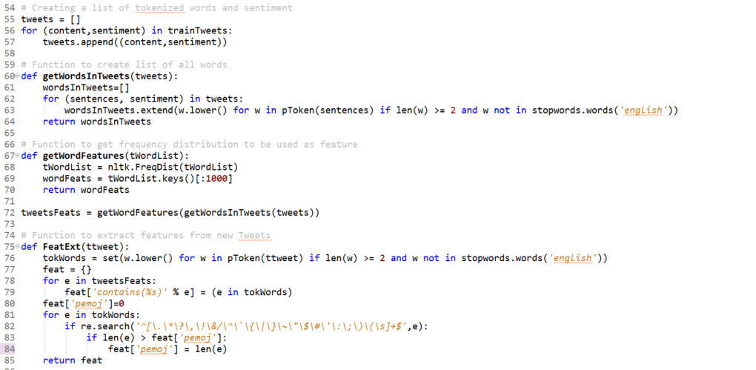
Feature Extractor:
The feature extractor in this project just checks for the occurrence of a word in the sentence and its it to the feature set, it also tries to obtain the length of the largest token considered as symbols.

Slide 16
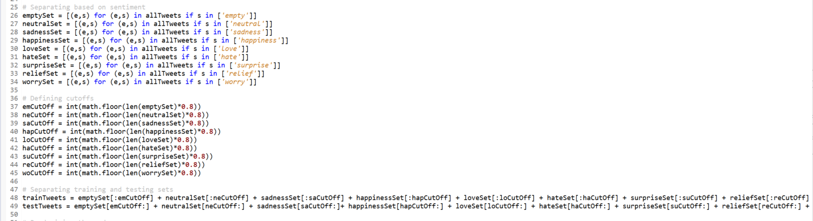
Training and Testing:
Separation into training and testing sets:

Slide 17
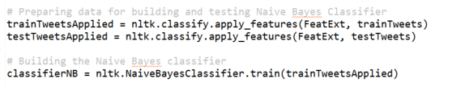
Training the Classifier:
We train the classifier with the prepared list of most important words and build it after applying features as follows:

Slide 18
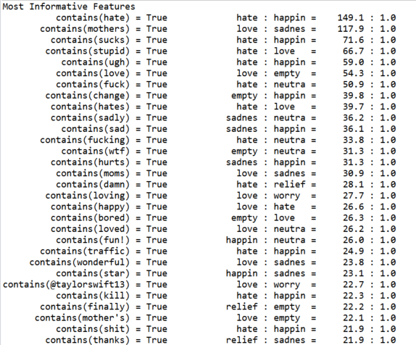

Slide 19
Evaluation:
Accuracy: a general measure of how many tweets were labelled correctly
Precision: a measure of false positives, higher precision means that fewer tweets have been labelled incorrectly
Recall: Higher recall would mean that fewer tweets with the desired label get placed in the wrong category.

Slide 20
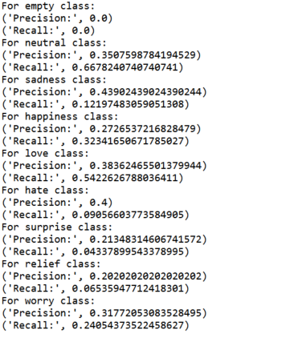
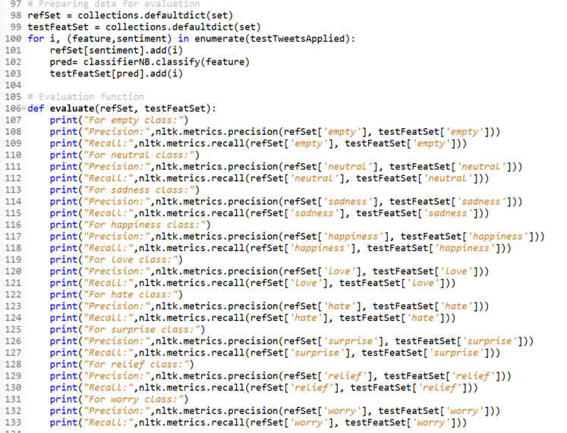
Evaluation:

Slide 21
Conclusion:
The original work attempted to use logistic regression to classify the textual data and for the most part it seems to work better than the Naïve Bayes Classifier constructed.
Model requires additional features to be added.
Implementation of tagger for classification may improve performance.
Naïve Bayes performed poorly for the purpose of classifying emotion of tweets based on the data.

Slide 22
Thank you

Slide 23
References and Resources:
“Natural Language Processing with Python” , Steven Bird, Ewan Klein, and Edward Loper, O'Reilly Media, 2009
“Text Classification for Sentiment Analysis – Precision and Recall”, Jacob, May17, 2010, streamhacker.com, (http://streamhacker.com/2010/05/17/text-classification-sentiment-analysis-precision-recall/)
“Sentiment Analysis: Emotion in Text”, CrowdFlower,Inc., July 15, 2016, (https://www.crowdflower.com/data-for-everyone/)
“Second Try: Sentiment Analysis in Python”, Andy Bromberg, (http://andybromberg.com/sentiment-analysis-python/)
“Twitter Sentiment Analysis using Python and NLTK”, Laurent Luce, January 2, 2012, (http://www.laurentluce.com/posts/twitter-sentiment-analysis-using-python-and-nltk/)
“Sentiment Symposium Tutorial: Language and Cognition”, Chirtopher Potts, Standford Linguistics, (http://sentiment.christopherpotts.net/lingcog.html)

